Slide 1

TYLER, ERIC, KATIE, JON
BRIDGING THE GAP
GENDER PAY GAP
EXPLORING THE PATH TO FAIRNESS FOR ALL
NEXT

Slide 2


BRIDGING THE GAP
Introduction
The gender pay gap remains a significant issue in employment and social economics, affecting industries and professions worldwide. Our project seeks to analyze the current state of the gender pay gap, exploring salary differences across job roles, seniority levels, industries, and regions. We’re using datasets from Kaggle and the Census to dive deep into the data and figure out the key factors that contribute to the gap, like education, industry type, or even social norms.
We’ll also check out how things have changed over time and try to predict when the gap might close if current trends continue. On top of that, we’re going to look at real-world examples of companies and countries that have made progress in closing the gap, like through union representation or pay equity audits. Our goal is to pull all of this together and offer some insights into how things could improve in the future.
A JOURNEY TOWARD EQUALITY IN PAY
NEXT

Slide 3
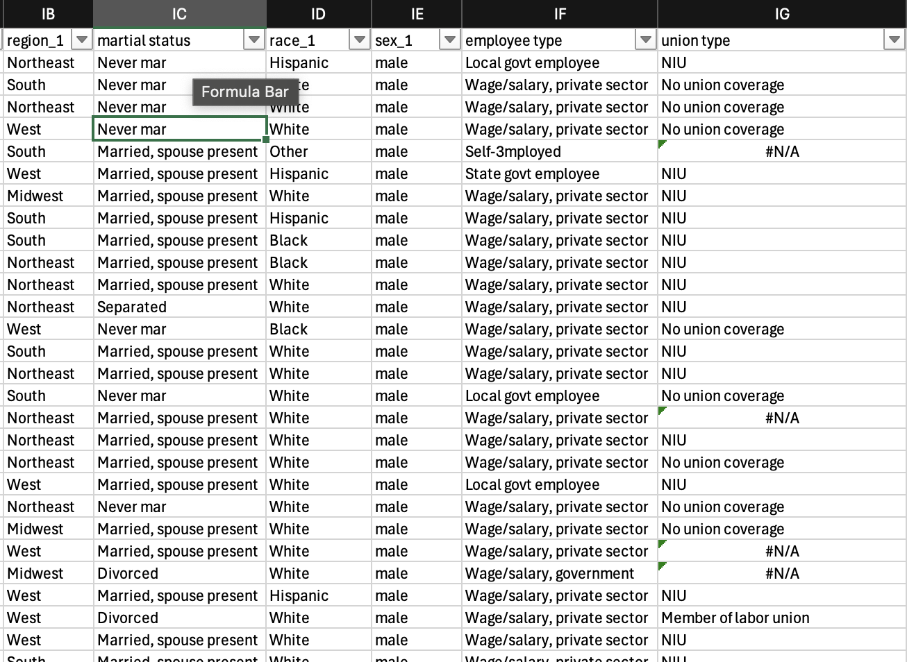
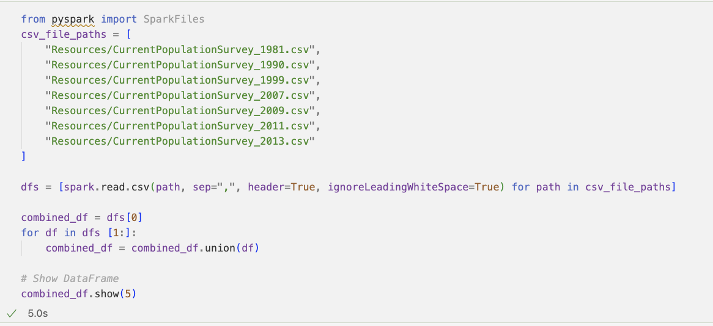
Process
BRIDGING THE GAP
WAGE GAP OVER TIME:
We began with a dataset containing over 300,000 rows and more than 200 columns. To make the data more manageable, we first performed a VLOOKUP to replace numerical codes with descriptive labels for certain columns. After identifying and removing unnecessary columns, we used PySpark to process the data efficiently. Due to the large file sizes, we split the dataset by year to ensure it could be imported into Git. The final datasets were saved and imported as CSV files.
CLEANING THE DATA PROCESS
NEXT

Slide 4


BRIDGING THE GAP
MILESTONES IN THE
TOWARD THE GENDER PAY GAP
Journey
THE EQUAL PAY ACT 1963
CIVIL RIGHTS ACT 1964
RIGHT TO VOTE 1920
is passed by Congress, making it illegal for employers to pay women lower wages than men for work requiring the same skill, effort, and responsibility. Employees suspecting pay discrimination have legal routes for recourse, including contacting an Equal Employment Opportunity counselor or directly filing a lawsuit.
The 19th Amendment, ratified in 1920, marked a pivotal moment in American history by granting women the right to vote across all states and in federal elections. Given that the fight for suffrage began in the 1800s, few of the original supporters lived to see the passage of the 19th Amendment. Throughout the struggle, suffragists faced harsh opposition, including heckling, physical assaults, and imprisonment. New York State's adoption of women's suffrage in 1917 and President Wilson's eventual support were milestones.
Title VII safeguards employees and job seekers from workplace discrimination or unfair wage gaps due to race, color, religion, sex, or national origin. It applies to all employment-related activities, from hiring and firing to promotions and working conditions, ensuring equal treatment in every aspect of employment.
HISTORICAL CONTEXT
NEXT

Slide 5
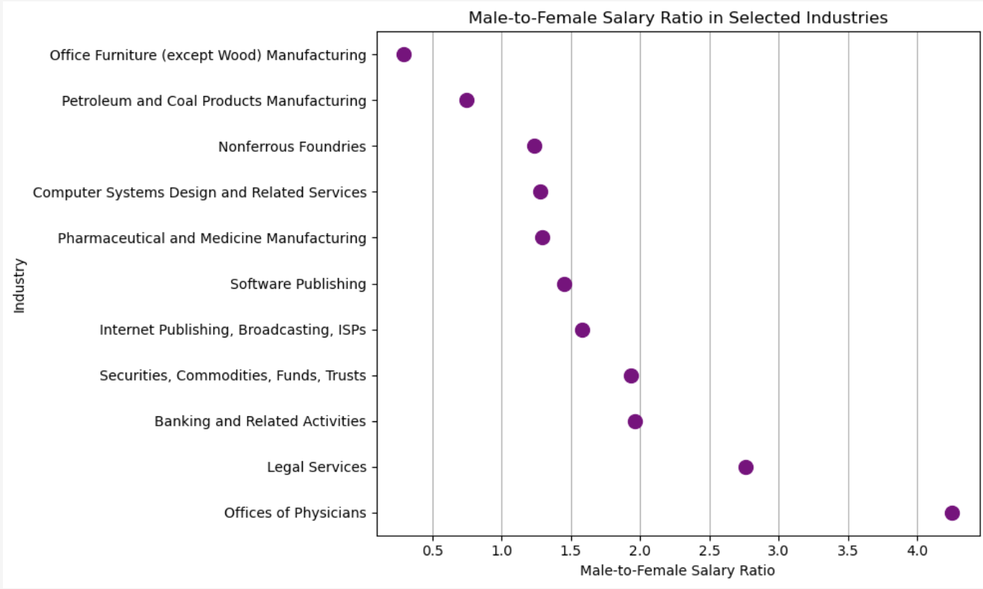
Gender Pay
Industries
BRIDGING THE GAP
Across
Male-to-Female Ratio(Top 10 industries based on Pay)=
Average Salary of Females/
Average Salary of Males
​
A ratio of 1 means that males and females earn the same average salary.
A ratio greater than 1 indicates that males earn more than females on average.
A ratio less than 1 indicates that females earn more than males on average.
Office Furniture and Gas/Coal Products Manufacturing are the only industries that females are paid more than male.
Industry Gaps
NEXT
Notes:
Non ferrous metals that do not contain iron in appreciable amounts. These metals are typically more resistant to corrosion and are lighter than ferrous metals (which contain iron). Non-ferrous metals are widely used in various industries due to their properties, such as high conductivity, low weight, and resistance to rust. Non-ferrous metals are also highly recyclable and are valuable in manufacturing processes due to their unique properties.

Slide 6
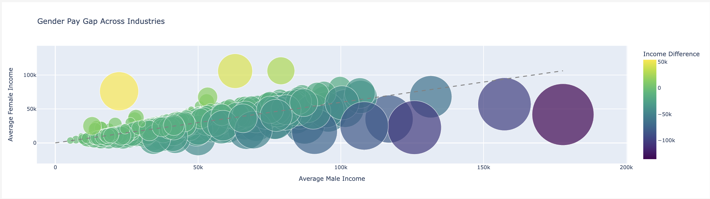
Gender Pay Industries
Across
BRIDGING THE GAP
Industry Gaps
NEXT
Notes:
The abs diff provides a clear and simple way to quantify the gender pay gap by showing how far apart male and female salaries are, regardless of which gender is on the higher side.

Slide 7
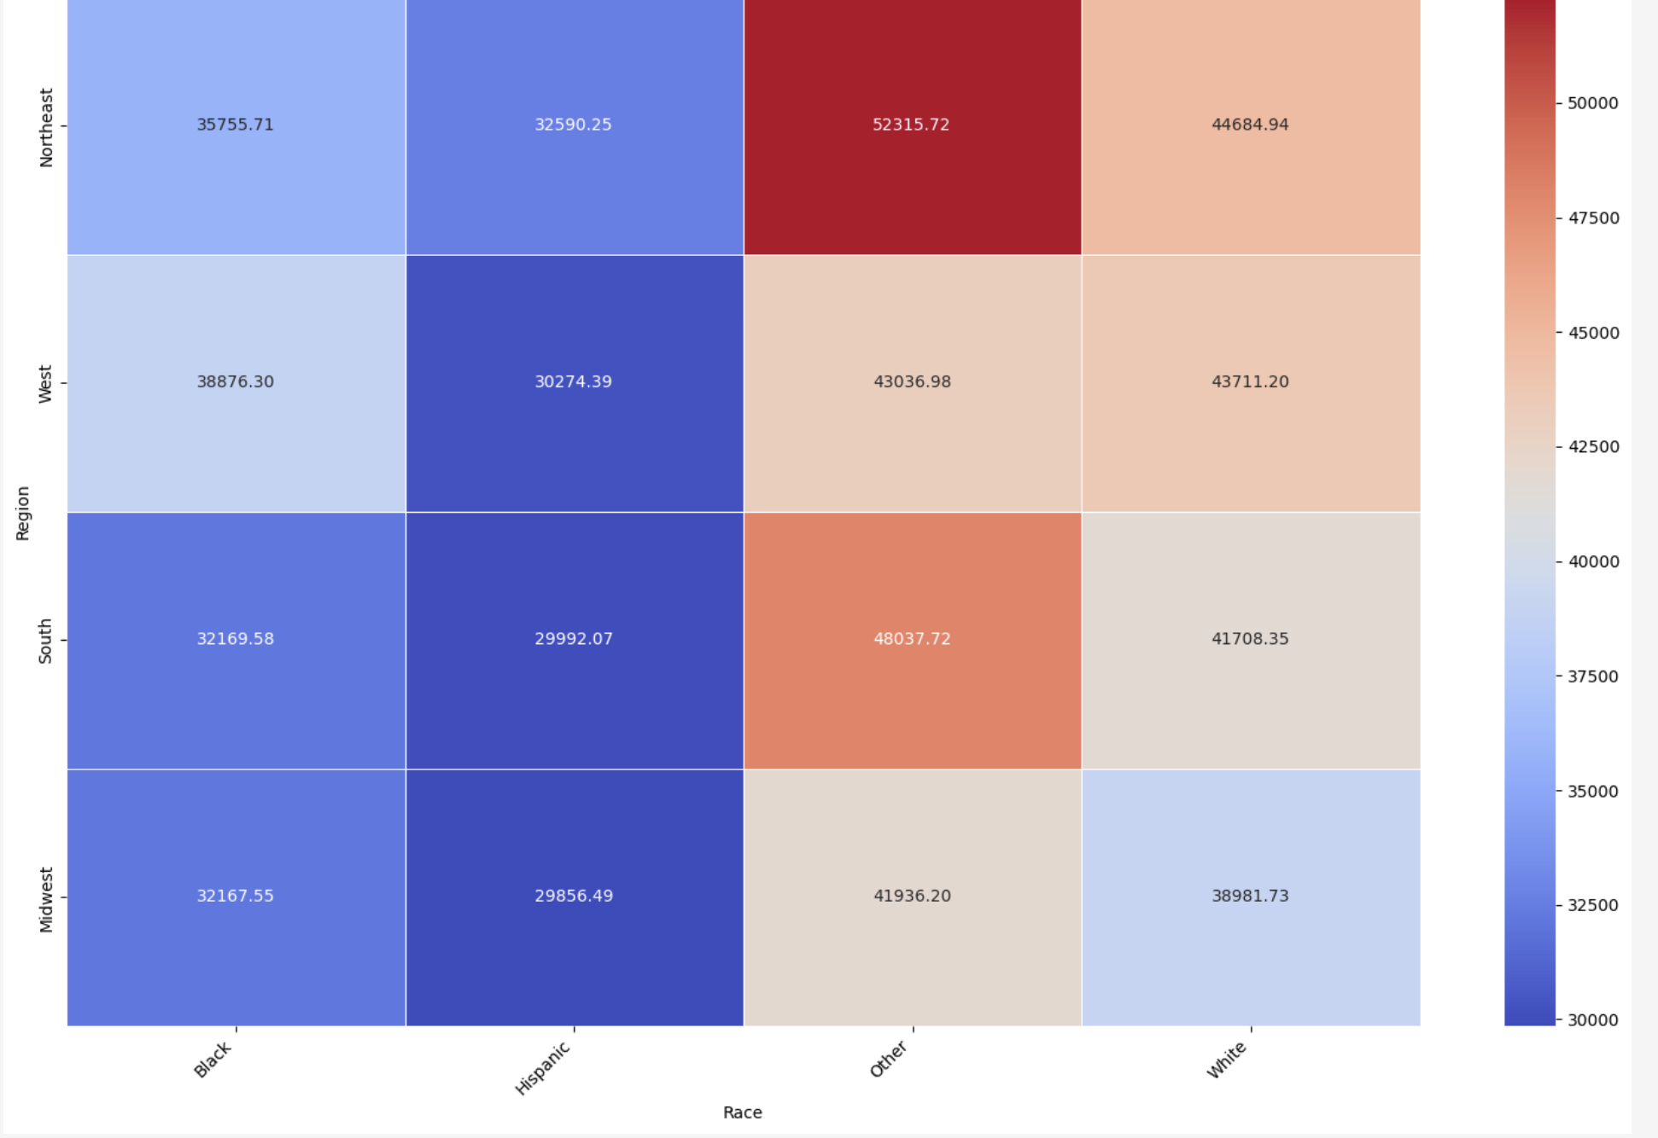
Pay
Region & Race
BRIDGING THE GAP
Across
Northeast tends to pay more in salary on average
Other and White get paid more
Hispanics out of all races get paid the least
Region Gaps
NEXT

Slide 8
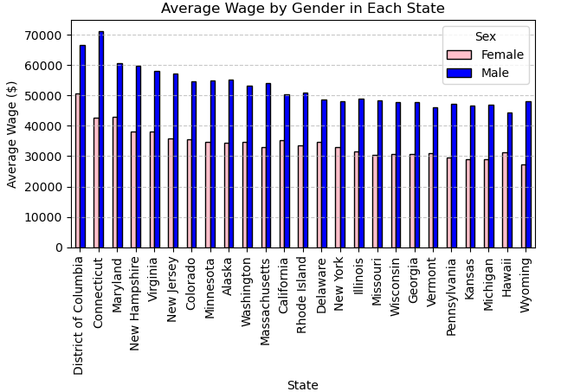
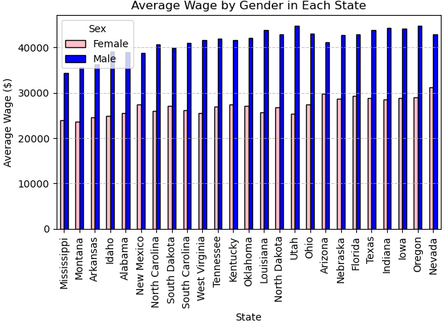
FACTORS CONTRIBUTING TO THE GENDER PAY GAP: ANALYZING BY STATE
v

Slide 9
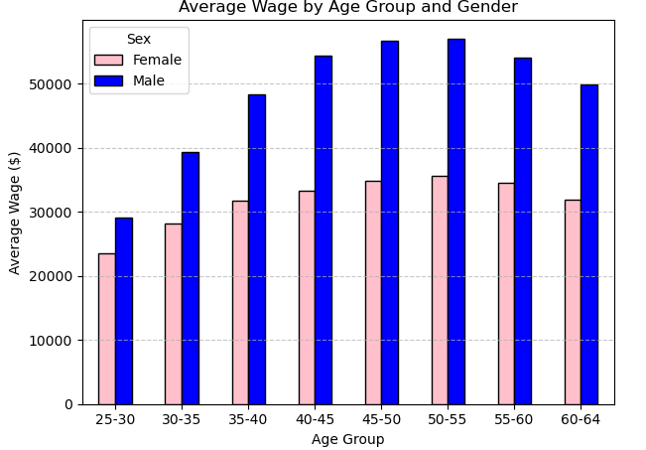
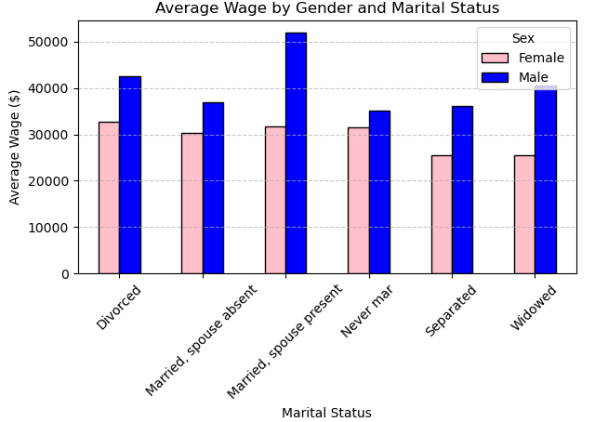
Pay
Region & Race
BRIDGING THE GAP
FACTORS CONTRIBUTING TO THE GENDER PAY GAP: ANALYZING BY AGE AND MARITAL STATUS
Across
Northeast tends to pay more in salary on average
Other and White get paid more
Hispanics out of all races get paid the least
Region Gaps
NEXT

Slide 10
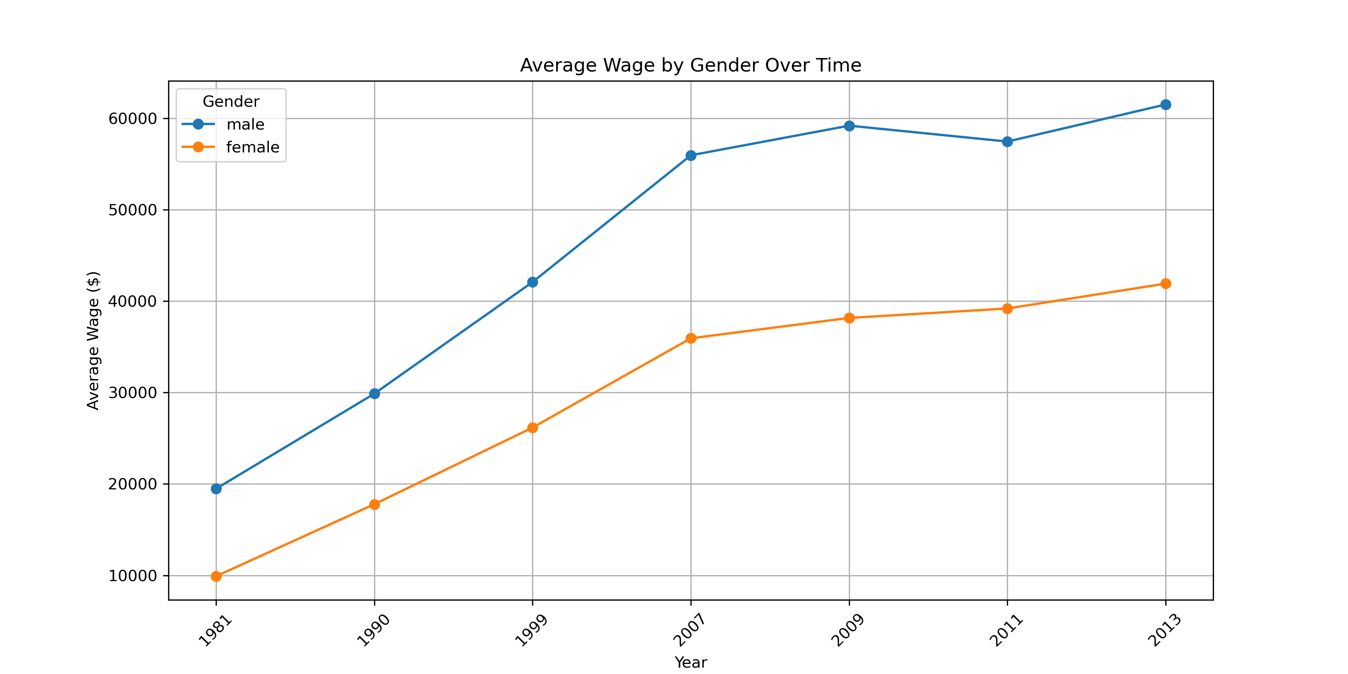
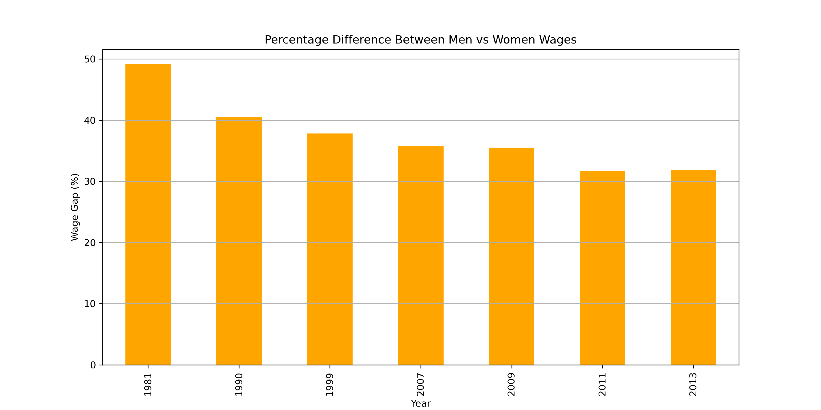
WAGE GAP OVER TIME: USD ($) AND PERCENTAGE (%) DIFFERENCE
v

Slide 11
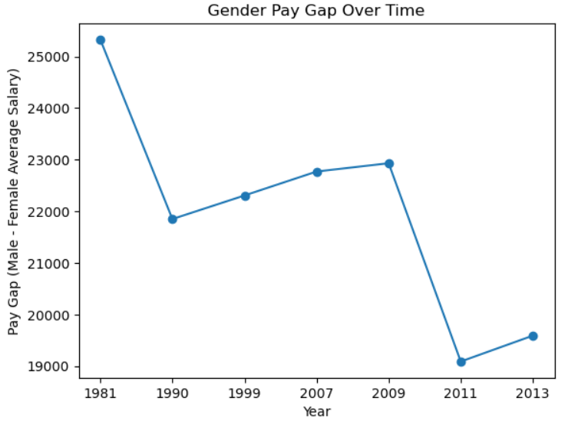
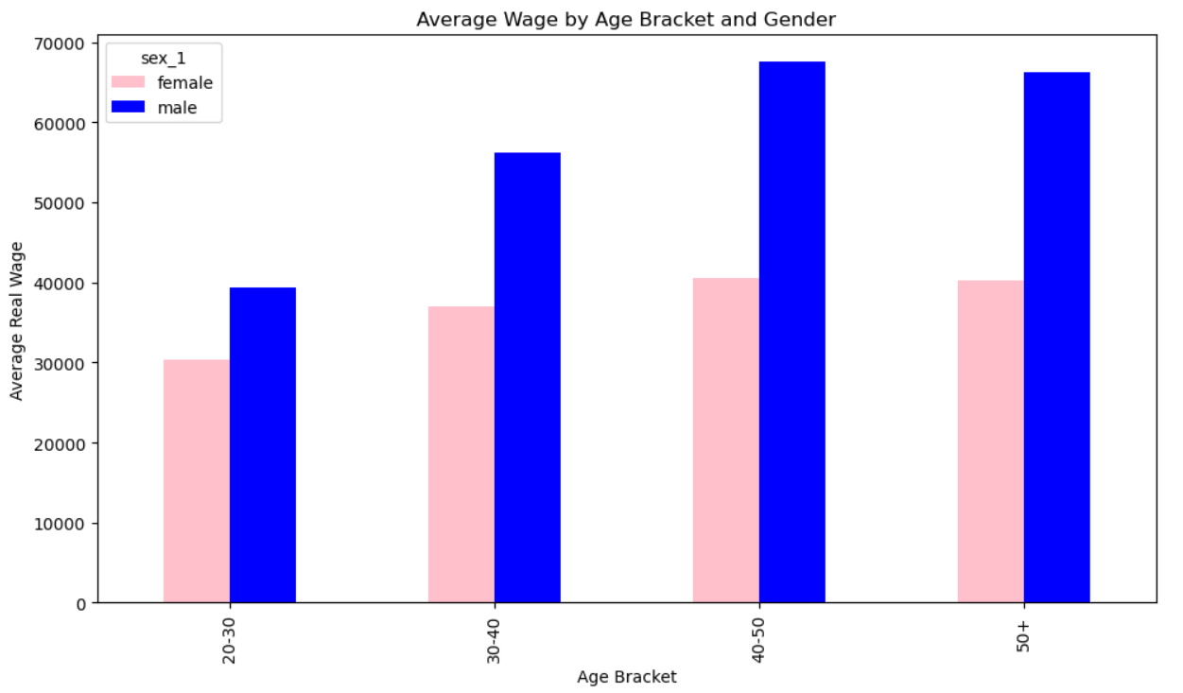
HISTORICAL TRENDS AND CAREER STAGES
The gender pay gap seems to increase with age, indicating that women earn comparatively less than men as they progress in their careers.
Despite the general downward trend, the pay gap is still substantial by 2013, indicating ongoing gender disparity in wages.

Slide 12
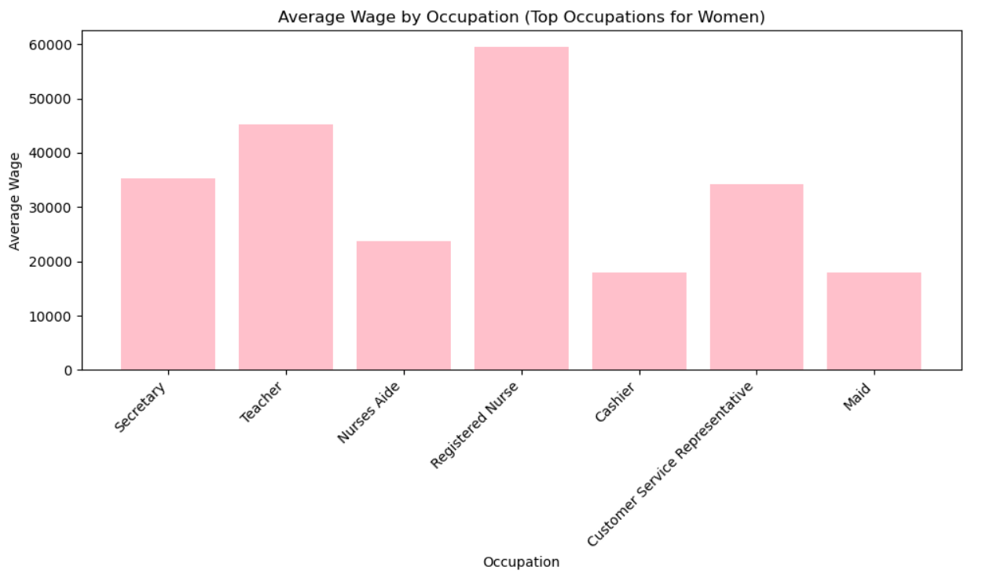
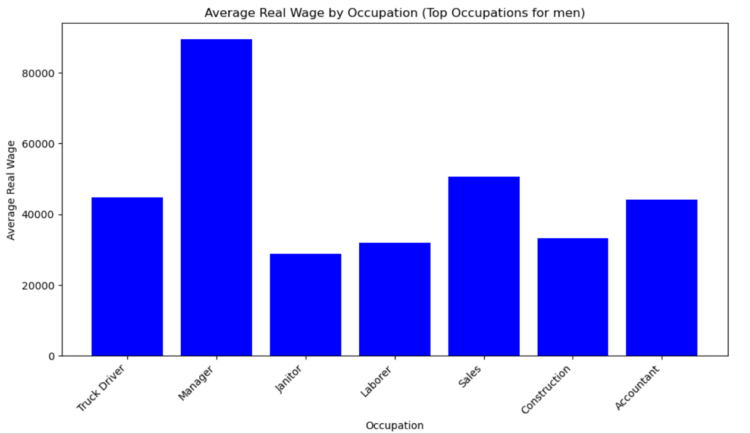
OCCUPATIONAL SEGREGATION
Women are overrepresented in lower-paid roles such as service, caregiving, and support positions, whereas men dominate higher-paid technical and managerial roles.

Slide 13

Machine Learning Application
Model goal: analyze and predict the gender gap %
Model type: regression
Model chosen: random forest regressor
Benefits to this model:
Ensemble learning
Bootstrap sampling (sampling with replacement)
Random feature selection
Averaging to final prediction
Downsides of other model options:
Linear regressions sensitivity to outliers
Overfitting risks of decision tree modeling
https://williamkoehrsen.medium.com/random-forest-simple-explanation-377895a60d2d

Slide 14

Building the Model
Data transformation:
Identification of features:
Input features: year, state, race, age, union type, marital status, and sex
Calculation of average income as grouped by input features,
Pivot data for separated male and female columns
Pay gap percentage calculation:
Difference between male and female averages for each feature grouping
Cleaning and model preparation:
Checking for NaN values, dtype conversion
One-hot-encoding categorial features
State, race, union type, marital status

Slide 15
Building the Model
Split and scale the data:
Separation of target vector (pay gap) and feature matrix
Train, test, split for separated training and testing sets
Use of standard scaler to standardize values for comparison
Initialize model and fit to data:
Initialize random forest regressor
Fit model to training data set
Make predictions:
Use model to predict the pay gap on the test set

Slide 16
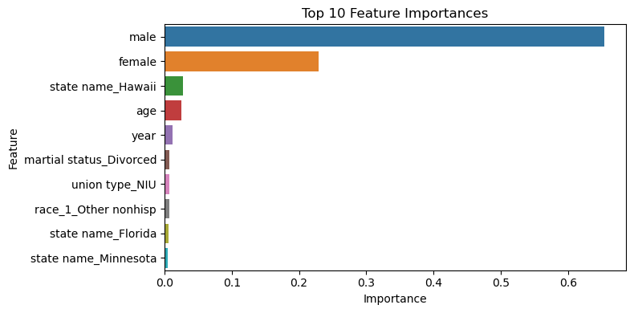
Evaluating the Model
Model evaluation included review of the output R² and MSE (Mean Squared Error) values
First model iteration:
R² = 0.8439
MSE = 10150.0645
Room for improvement!
Feature importance Analysis:
Method of extracting and sorting features by impact on the model
Helped identify features possibly hindering the model's performance

Slide 17
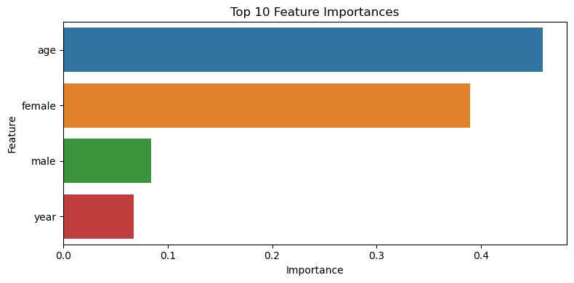
Evaluating the Model
Model steps repeated with reduced features
Sex, age, and year
Improvement was made in both scores:
R2 = 0.92405
MSE = 8.0346
Focusing on these inputted features improved model accuracy and reduced prediction error
This achieves our goal of creating a model that can accurately predict pay gap

Slide 18

Using the Model
Observation of pay gap trends over time
Evaluation of policy changes through measurement of the pay gap following policy implementation
Draw insight on demographic features that may affect gender pay gap
Identify the pay gap of specific groups
Experiment with hypothetical scenarios that would allow us to see potential pay gap effects

Slide 19


BRIDGING THE GAP
Research shows that gender-based pay differences often cannot be fully explained by objective factors like occupational segregation, work experience, or education. Unexplained components of the wage gap are linked to biases, stereotypes, and lack of transparency in pay-setting. Studies indicate that mandated disclosure of company-level pay data is an effective policy for reducing this gap. Key reasons why transparency matters include:
Awareness and Accountability: Open pay practices increase awareness of disparities, compelling organizations to justify unexplained differences.
Identification of Inequities: Mandated reports prompt employers to analyze pay structures and collect standardized data, uncovering previously ignored inequities.
Competitive Pressure: Public disclosure creates incentives for companies to improve their standings relative to industry peers to avoid criticism over unexplained pay gaps.
Bargaining Power: Transparency enhances employees' ability to negotiate fair wages, especially for women who may lack access to pay information.
TRANSPARENCY AND PAY EQUITY AUDITS
BENEFITS OF TRANSPARENCY & PAY AUDITS
NEXT

Slide 20

BRIDGING THE GAP
SUCCESS
Stories
Several countries have introduced legislation requiring private sector employers to submit annual reports on compensation, with notable examples:
Iceland: Companies with 25+ employees must obtain government certification of equal pay every three years, facing fines if they fail.
United Kingdom: The Equality Act 2010 mandates private firms to report their overall gender pay gap annually.
Australia: The Workplace Gender Equality Act requires non-public sector agencies with 100+ employees to disclose gaps in salary by gender.
GENDER EQUALITY
Notable companies have embraced pay transparency through audits and open reporting:
Salesforce: Conducts annual pay audits and has spent over $16 million to correct disparities.
Buffer: Publicly shares all employee salaries, fostering trust and equity.
Adobe: Regular audits led to $1 million in salary adjustments to achieve pay equity.
LinkedIn: Conducted audits resulting in the closure of the global gender pay gap.
SUCCESS STORIES IN PROMOTING EQUALITY
NEXT
Notes:
Iceland: Unexplained pay gap reduced from 14.5% to 12.6% post-reform (Johnson, 2019).UK: Reporting revealed an average pay gap of 18.4%, prompting pay audits and adjustments (Bol et al., 2021).Australia: Pay gaps narrowed in industries with disclosed statistics (Diem, 2019).

Slide 21

BRIDGING THE GAP
US Pay Reporting Requirements
In the U.S., some federal and state-level pay reporting requirements exist:
EEOC Reporting: Employers with 100+ employees submit EEO-1 reports on employee demographics, indirectly contributing to pay equity analysis.
State Regulations: States like California and Colorado have stringent laws requiring pay data reporting, including median and mean wages by gender and ethnicity.
Local Ordinances: Cities like New York have laws mandating salary range disclosures in job postings, promoting transparency.
Proposed Legislation: The Paycheck Fairness Act aims to strengthen reporting requirements but has not yet passed.
US REQUIREMENTS
NEXT

Slide 22


BRIDGING THE GAP
RECAP OF KEY POINTS
Although progress has been made in narrowing gender pay differences, significant gaps persist due to various factors. Mandatory public reporting of pay data has proven effective in addressing inequities by encouraging accountability and competition among firms. Organizations can adopt practices similar to successful reporting requirements—such as conducting pay audits, enhancing transparency, training leaders, and committing to ongoing evaluations—to promote pay equity.
Thank you!
CONCLUSION

Slide 23
Questions?

Slide 24
Links/References
Blau, F. D., & Kahn, L. M. (2017). The gender wage gap: Extent, trends, and explanations. Journal of Economic Literature, 55(3), 789–865.
Goldin, C. (2014). A grand gender convergence: Its last chapter. American Economic Review, 104(4), 1091–1119.
Gupta, N. D., Poulsen, A., & Villeval, M. C. (2018). Gender matching and competitiveness: Experimental evidence. Economic Inquiry, 58(1), 162–178.
Levanon, A., England, P., & Allison, P. (2009). Occupational feminization and pay: Assessing causal dynamics using 1950–2000 U.S. Census data. Social Forces, 88(2), 865–891.
Mandel, H., & Semyonov, M. (2014). Gender pay gap and employment sector: Sources of earnings disparities in the United States, 1970-2010. Demography, 51(5), 1597–1618.
O’Neill, J., & O’Neill, D. M. (2012). What do wage differentials tell us about labor market discrimination? In Handbook of labor economics (Vol. 3, pp. 793–862).
Weichselbaumer, D., & Winter-Ebmer, R. (2005). A meta-analysis of the international gender wage gap. Journal of Economic Surveys, 19(3), 479–511.
World Economic Forum. (2024). Gender Gap Accelerators: Benefits Over 850,000 Women.
Psico-Smart. (2024). Case Studies: Successful Implementation of Salary Equity Strategies in Various Industries.

Slide 25
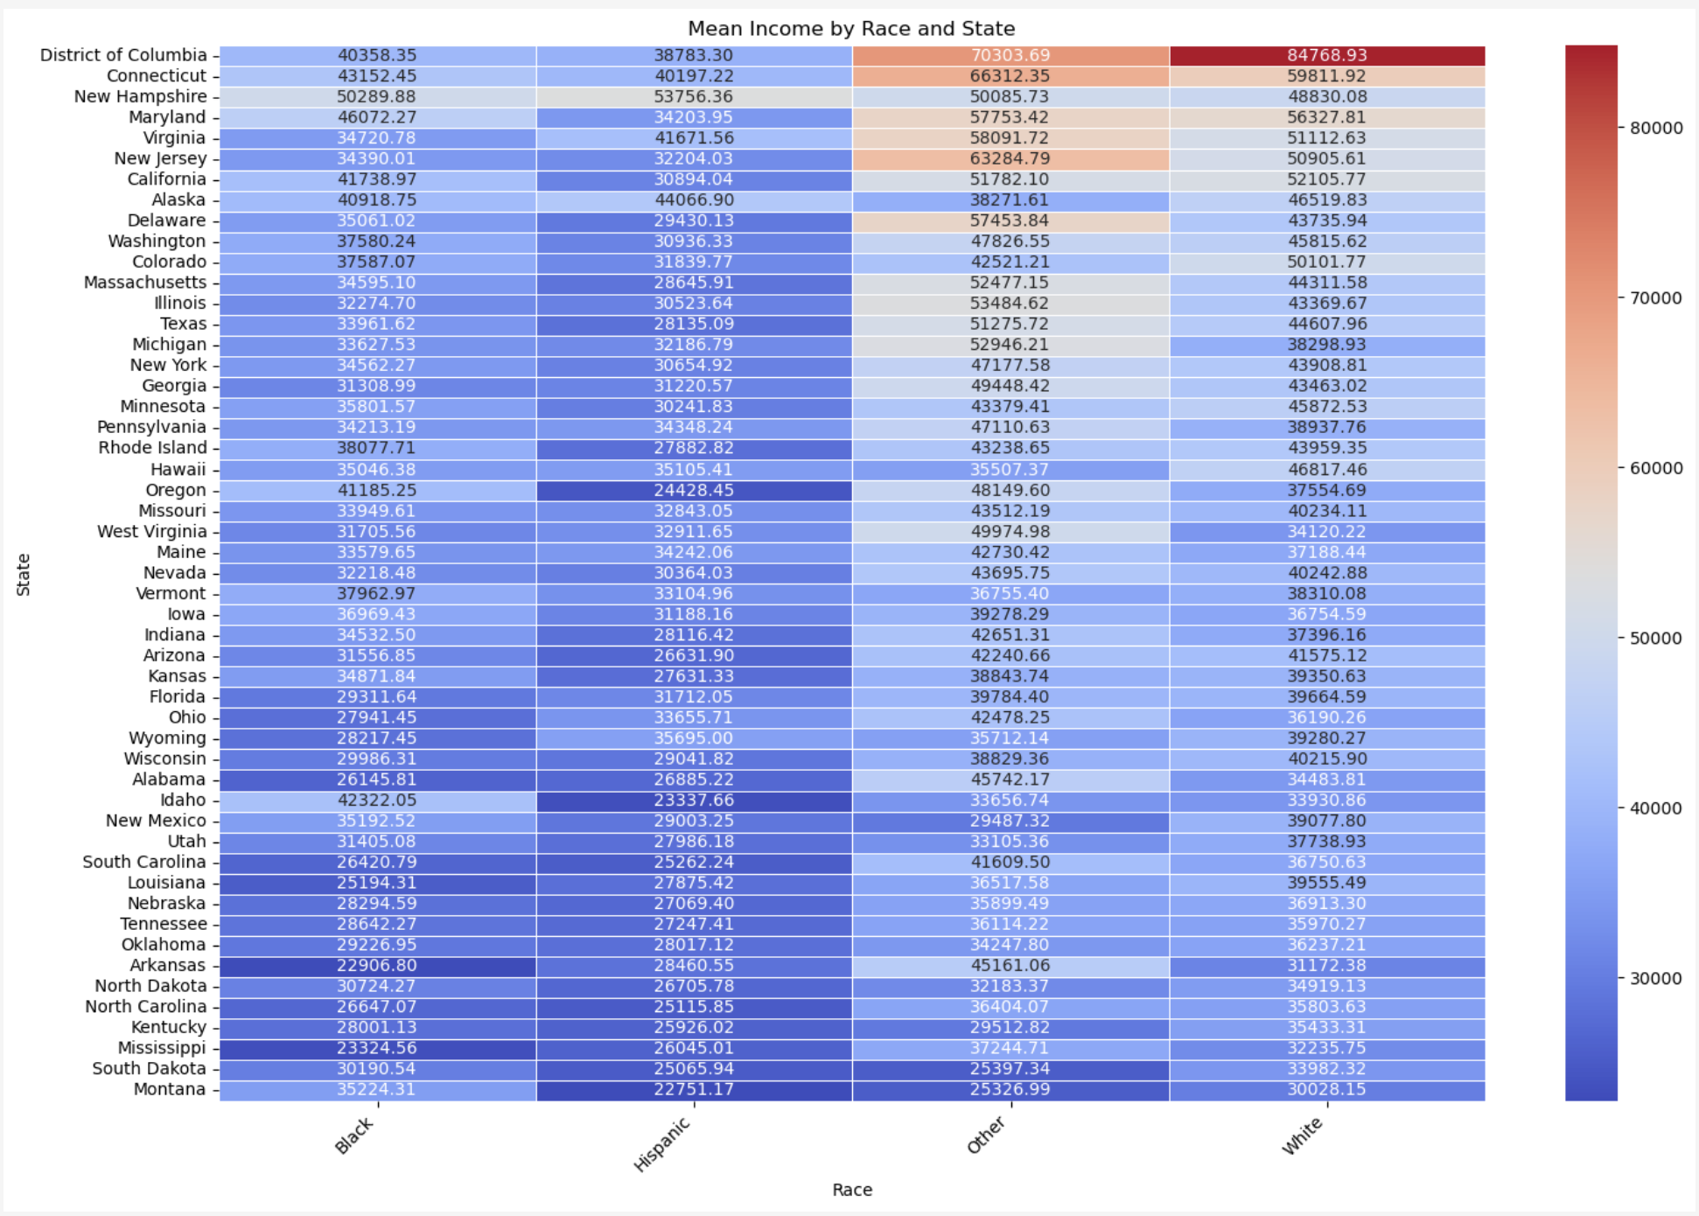
BRIDGING THE GAP
Pay
Race & State
Across
State Gaps
NEXT

